Slide 1
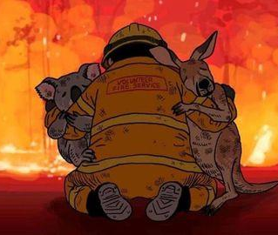

FiRescue
Team Members:
Anthony Prajwal
Ayush Bihani
Deepthi Bhat
Karthik Bhat
Nisha Mariam Thomas

Slide 2
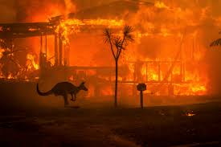
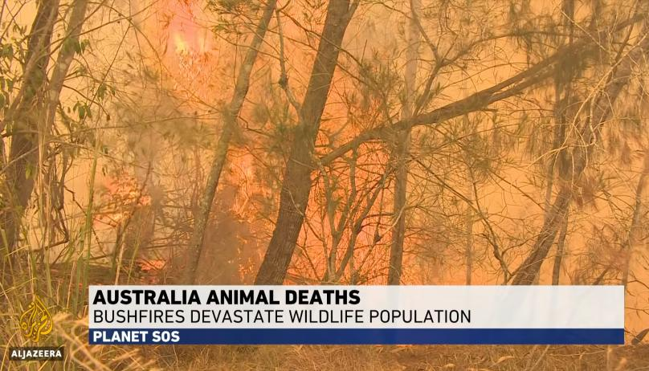
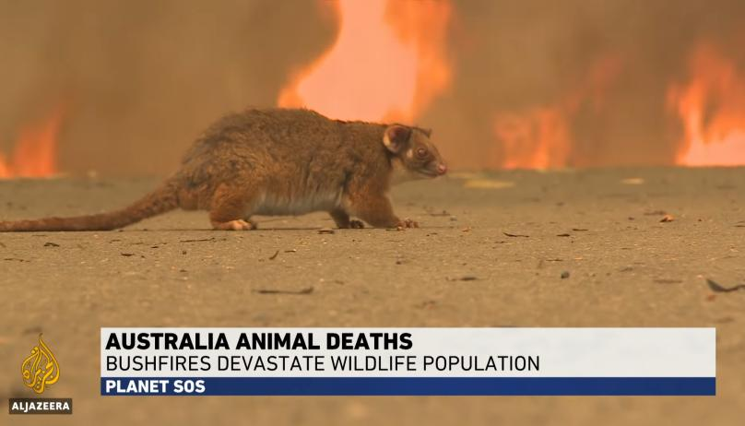
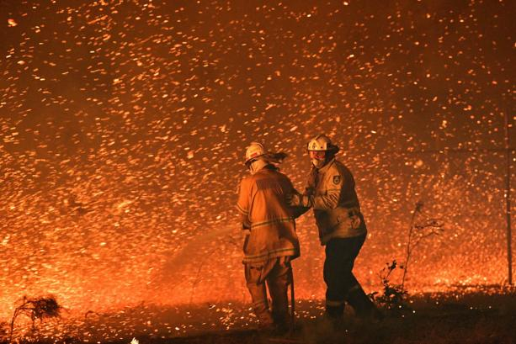

Slide 3
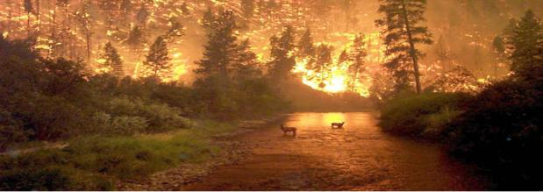
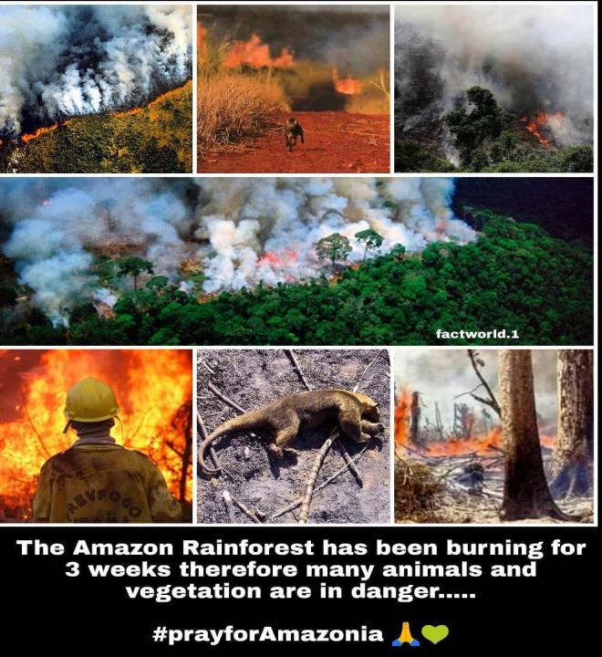
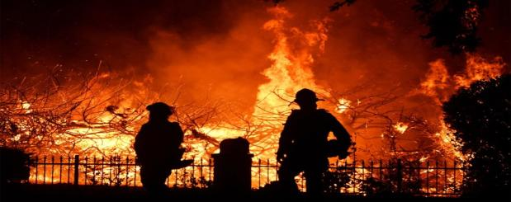
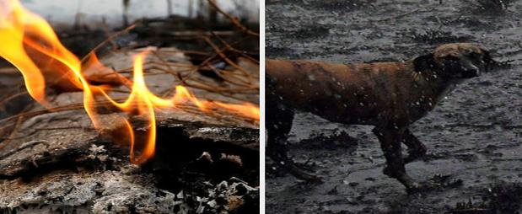

Slide 4
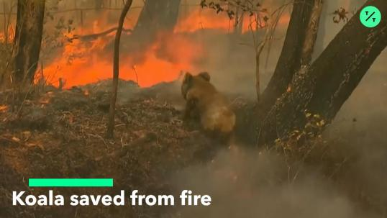
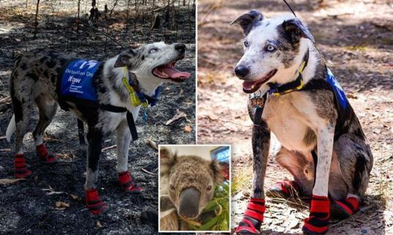
Game play:
A design of dog agents/bots that go into the forest to save wildlife from forest fire.

Slide 5
Software Environment
CSCI 599: Applied Machine Learning for Games
1. Install Unity3D (v 2018.4)
2. Install Python (v 3.6.1)
3. Install the com.unity.ml-agents Unity packages
4. Install the ml-agents Python package

Slide 6
Environment Details
1. Forest Terrain
2. Dog Agent
3. Safe Zone (denoted by a girl)
4. Vulnerable animals stuck in fire with health bar attached to them

Slide 7
Algorithm 1:
Proximal Policy Optimization (PPO)
The proximal policy optimization (PPO) is a model-free, on-policy, policy gradient reinforcement learning method.
This algorithm is a type of policy gradient training that uses stochastic gradient descent.

Slide 9
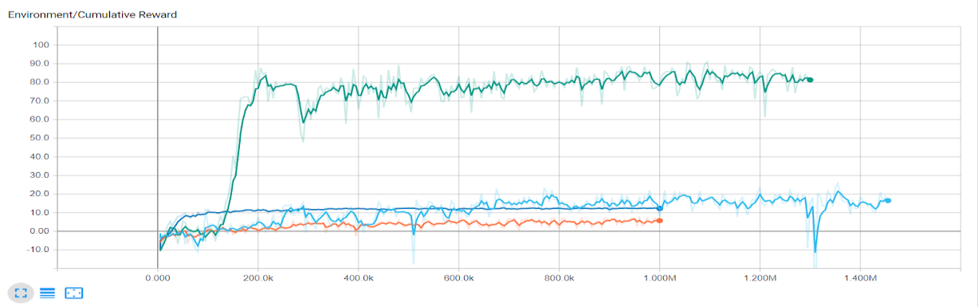

Slide 10
A demo of our PPO agent

Slide 11
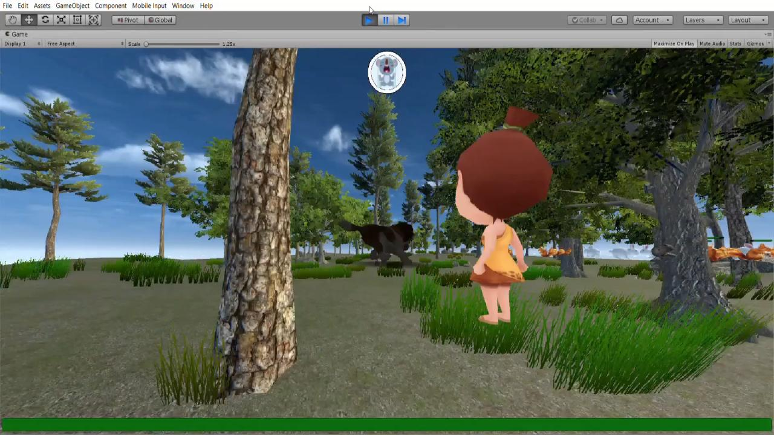

Slide 12
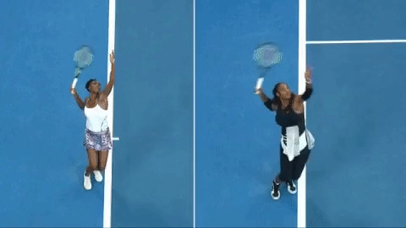
Algorithm 2:
Imitation learning - Behavioral Cloning (BC)
Behavioral Cloning learns a policy as Supervised Learning problem over state-action pairs from expert trajectories.
Created a demo of the game and extracted its meta data.
Used a combination of the demo frames and reinforcement learning to train our dog agent.
Tried a 0.7 BC strength and 0.5 BC strength. (Surprisingly 0.7 tried to overfit, and 0.5 did a better job training!)

Slide 13
Algorithm 2.1:
Behavioral cloning – 0.5 strength

Slide 15
A demo of our BC – 0.5 Strength agent

Slide 16
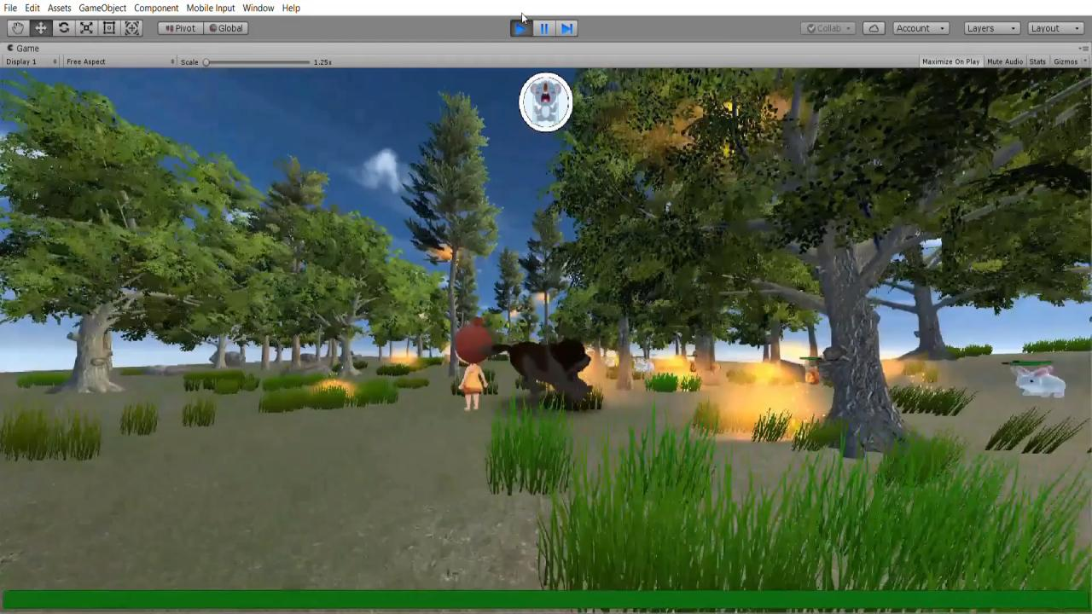
CSCI 599: Applied Machine Learning for Games

Slide 17
Algorithm 2.2:
Behavioral cloning – 0.7 strength

Slide 19
A demo of our BC – 0.7 Strength agent

Slide 20
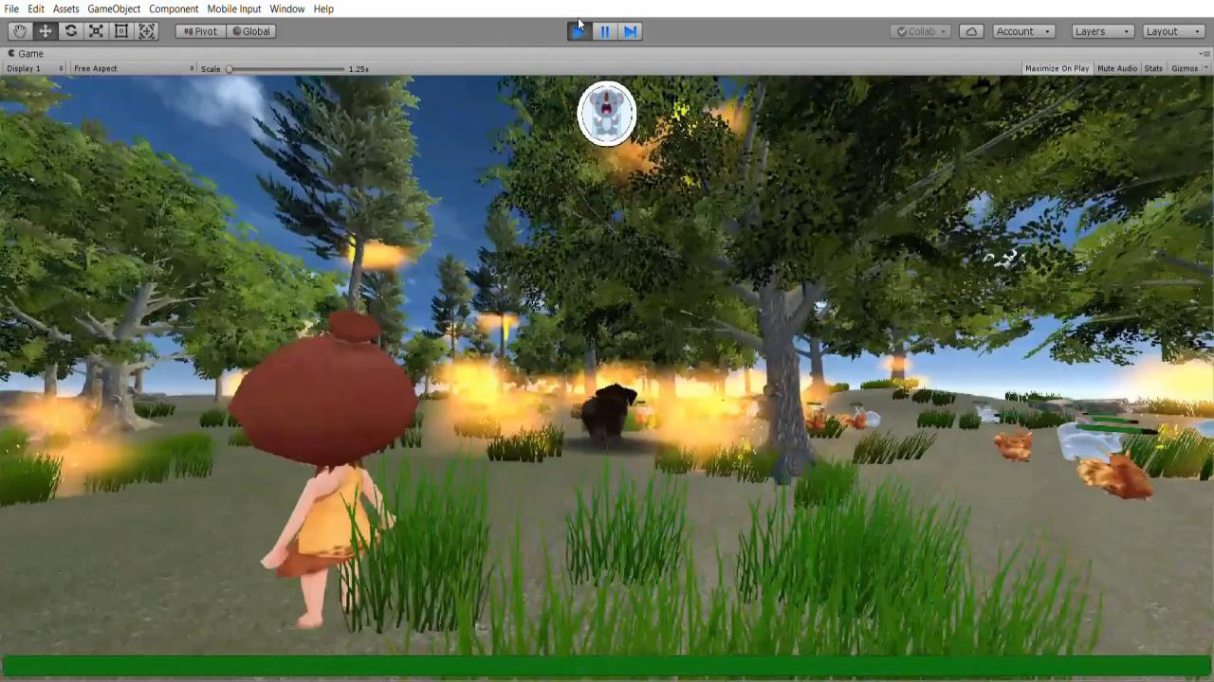

Slide 21
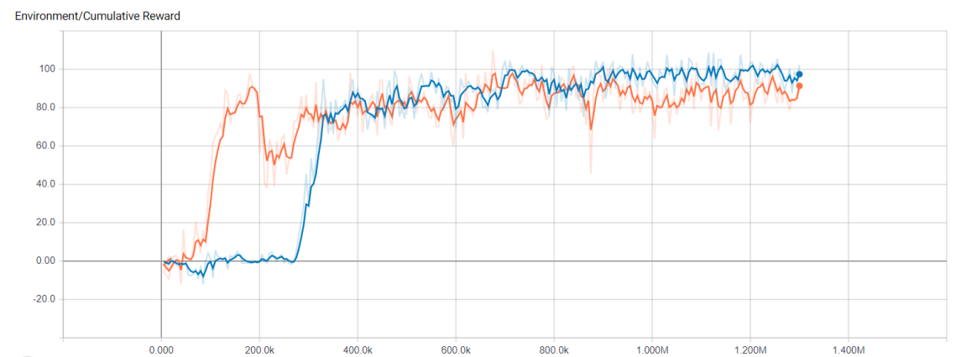

Slide 22
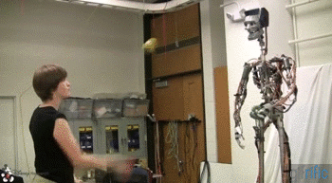
Algorithm 3:
Generative adversarial imitation learning (GAIL)
GAIL – Model-free imitation Learning that imitates complex behaviors. It is an advanced version of a combination of Reinforcement Learning and Inverse Reinforcement Learning (IRL).
Created a demo of the game and extracted its meta data.
Used a combination of the demo frames and reinforcement learning to train our dog agent.

Slide 23
Algorithm 3.1:
GAIL – 0.5 strength

Slide 25
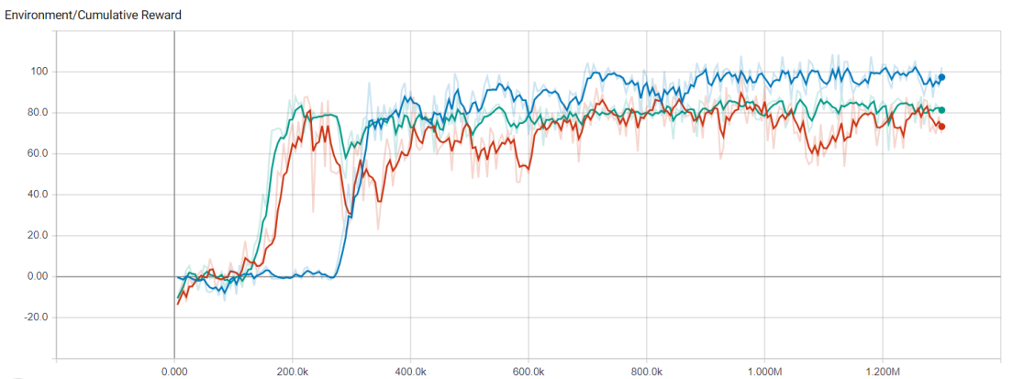

Slide 26
A demo of our GAIL – 0.5 Strength agent

Slide 27
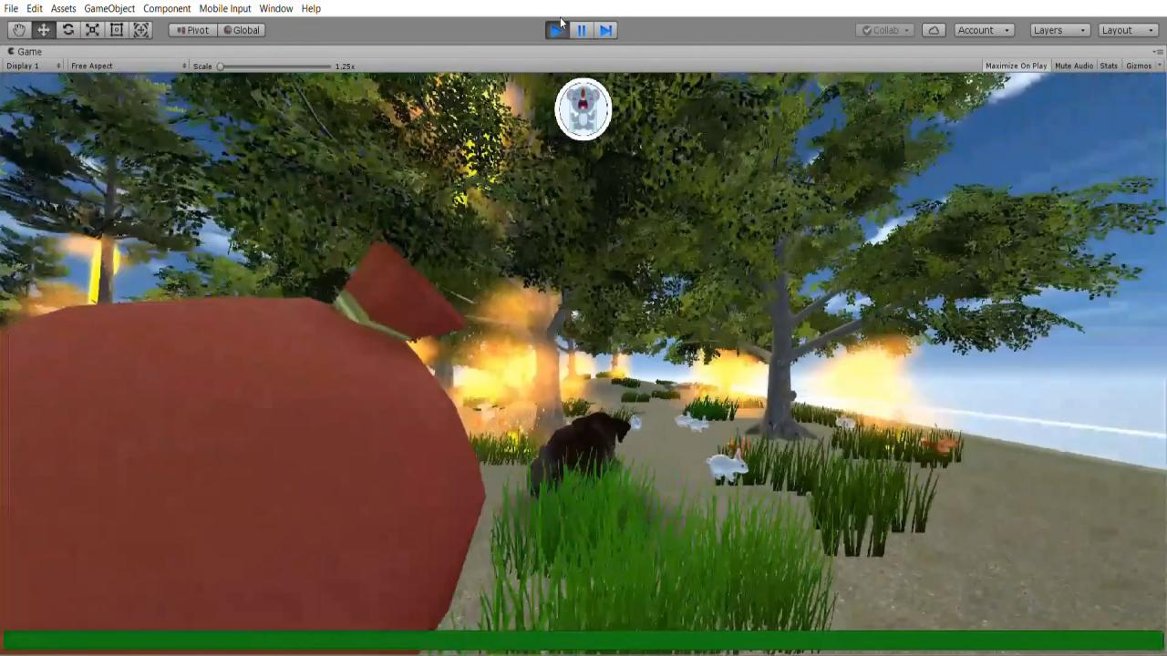

Slide 28
Algorithm comparison

Slide 29


Slide 30
Try ‘Soft Actor Critic’ algorithm
Train a separate YOLO object detection neural network
Possible future work
Transfer brains to dog bots
Add pretrained VGG neural network model for precision

Slide 31
References
CSCI 599: Applied Machine Learning for Games
https://unity3d.com/get-unity/download
https://github.com/Unity-Technologies/ml-agents
https://subscription.packtpub.com/book/game_development/9781789138139/1/ch01lvl1sec14/academy-agent-and-brain
https://medium.com/@sanketgujar95/generative-adversarial-imitation-learning-266f45634e60
https://github.com/Unity-Technologies/ml-agents/blob/master/docs/Training-Imitation-Learning.md
https://github.com/Unity-Technologies/ml-agents/blob/master/docs/Training-PPO.md
https://freesound.org/
https://www.blender.org/

Slide 32
THANK You

